Slide 1

Introduction to SINGLE CELL RNA-SEQ
CRUK CI Bioinformatics Summer School 2020
Katarzyna Kania, 24th July 2020

Slide 2
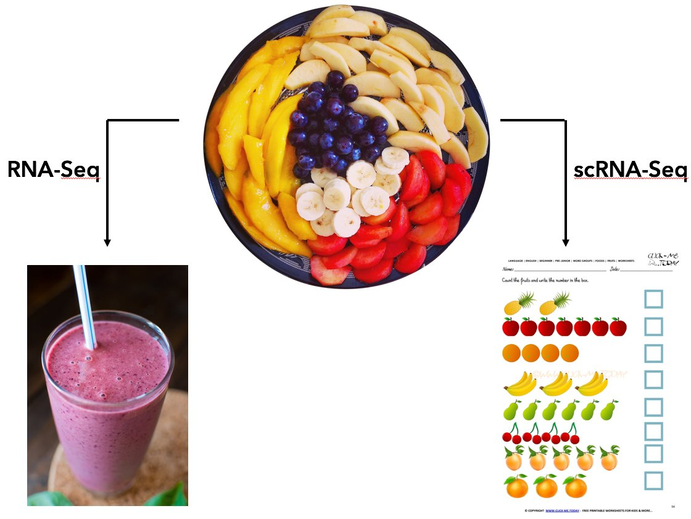
Bulk vs single cell rna-seq
Average expression level
Comparative transcriptomics
Disease biomarker
Homogenous systems
Separate populations
Define heterogeneity
Identify rare cell populations
Cell population dynamics

Slide 3
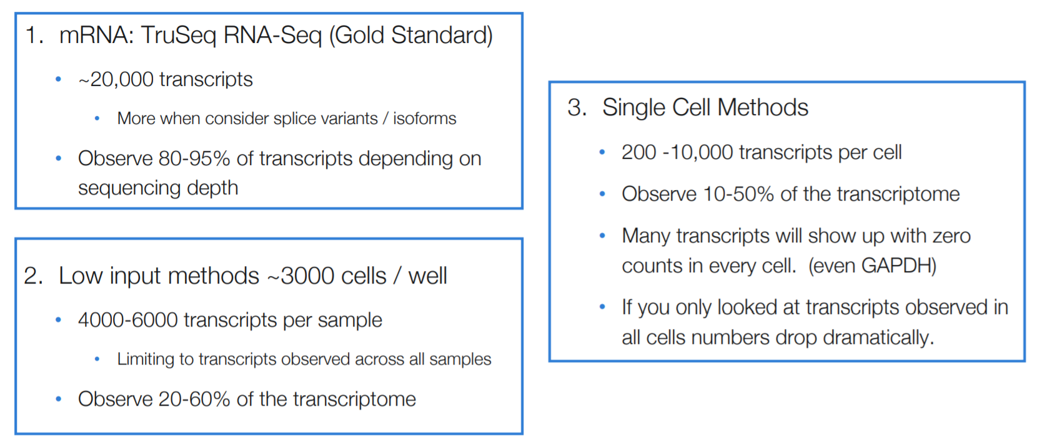
Bulk vs single cell rna-seq
Source: Sarah Boswell, Harvard Medical School, September 2020

Slide 4
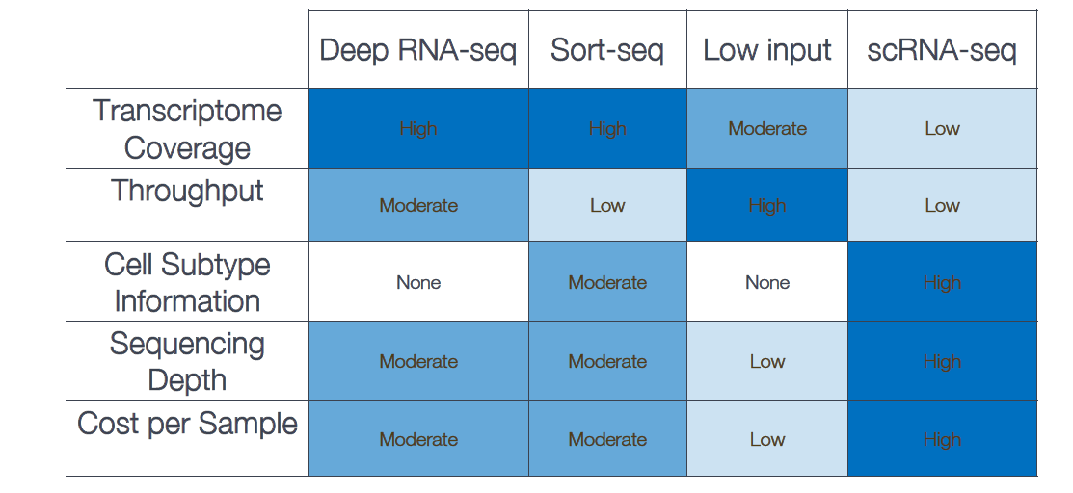
Bulk vs single cell rna-seq
Disadvantages of scRNA-seq
Dropouts and noisy data
Lowly expressed genes might be undetected
Samples will contain doublets
Replicates without batch effect are unlikely
Expensive
Source: Sarah Boswell, Harvard Medical School, September 2020

Slide 5

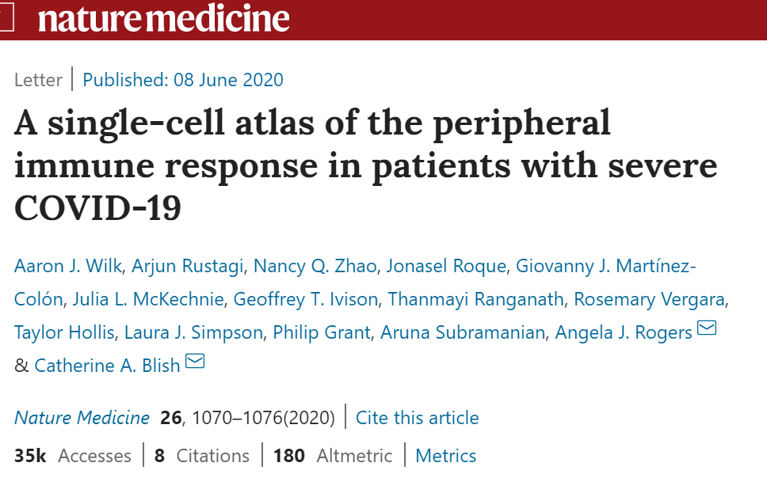
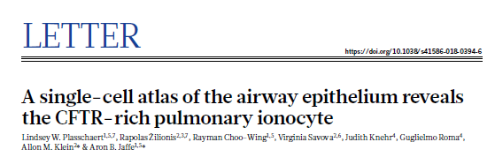
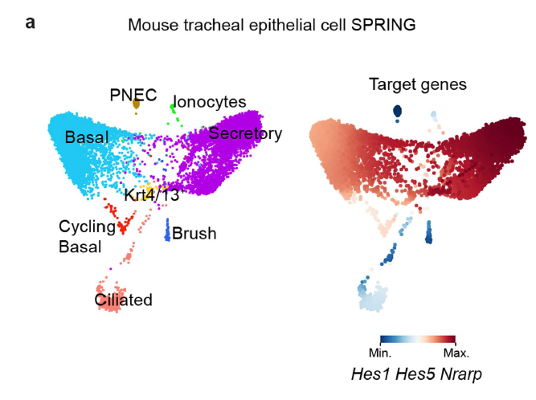
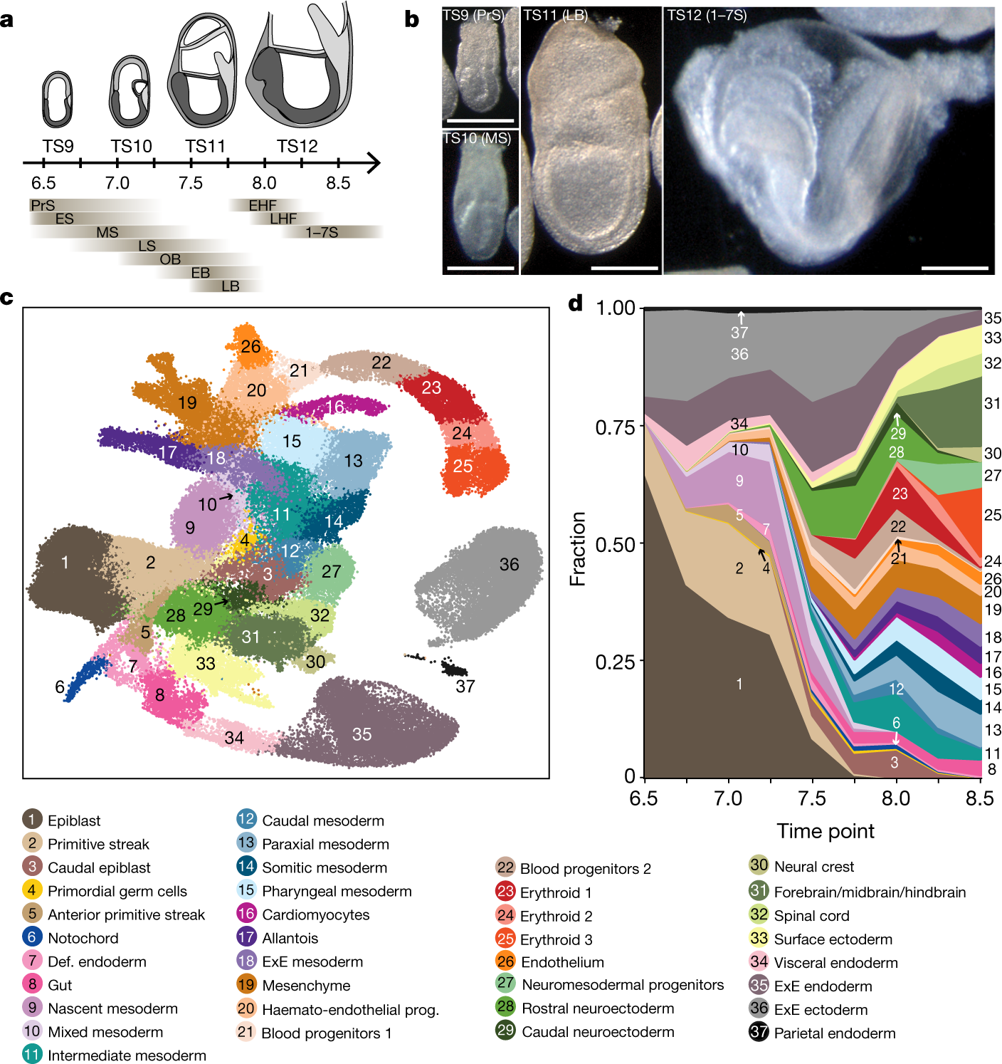
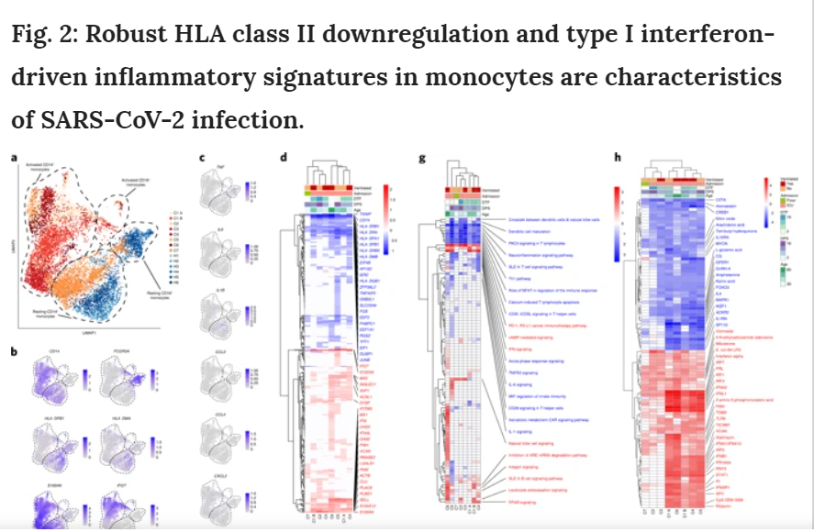
applications
Studying heterogeneity
Development lineage tracing
Studying cellular responses
Source: Plasschaert et al. Nature 560, 377–381 (2018)
Source: Pijuan-Sala et al. Nature 566, 490–495 (2019)
Source: Wilk et al. Nat Med 26, 1070–1076 (2020)

Slide 6

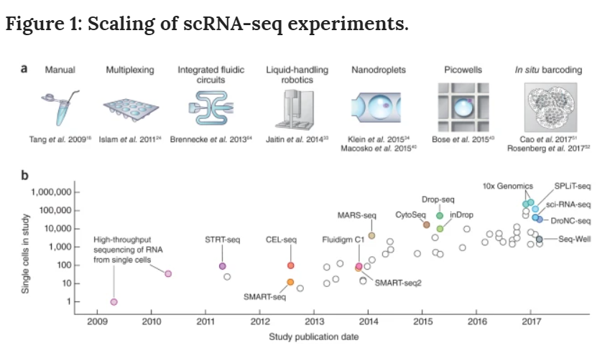
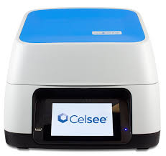
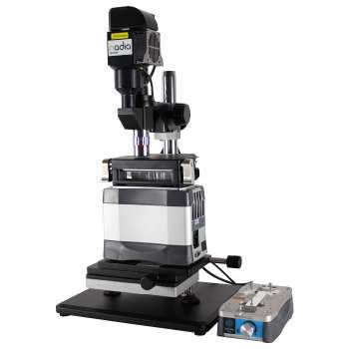
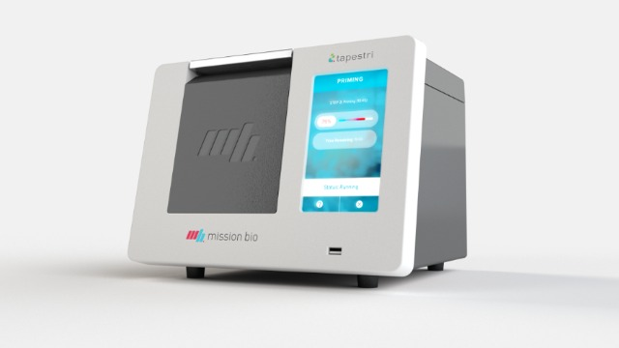
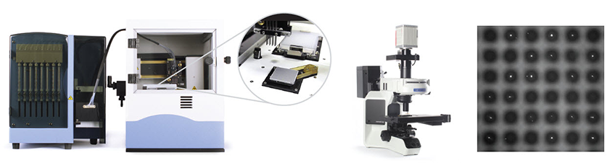
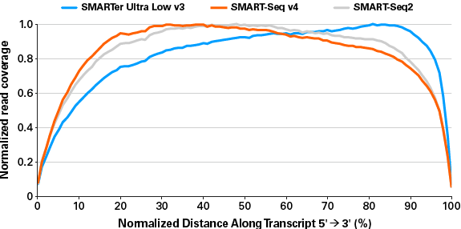
Technologies
Source: Svensson et al. Nat Protoc 13, 599–604 (2018)

Slide 7
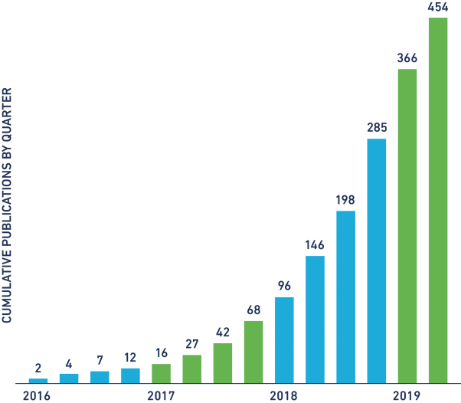
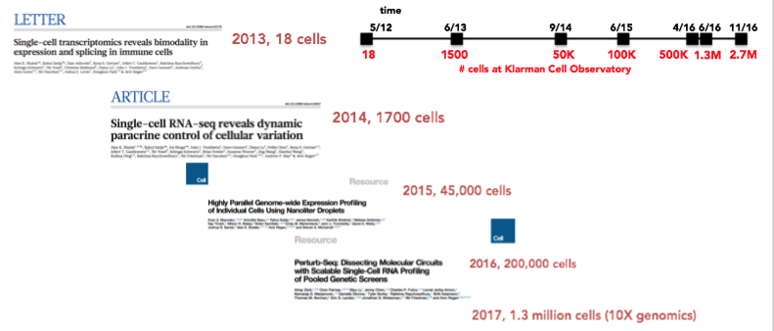
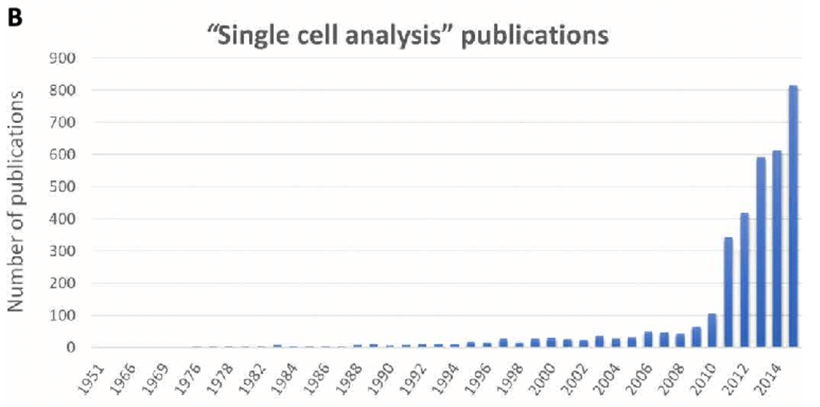
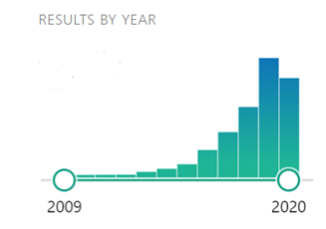
History and progress
Publications using 10x Genomics
Source: Introduction to scRNASeq, Timothy Tickle & Brian Haas, Broad Institute, 2017
Source: https://www.sec.gov/Archives/edgar/data/1770787/000119312519224368/d737378ds1.htm
PubMed search for ‘scRNA-seq’
Roy et al. Science Advances (2018)

Slide 8

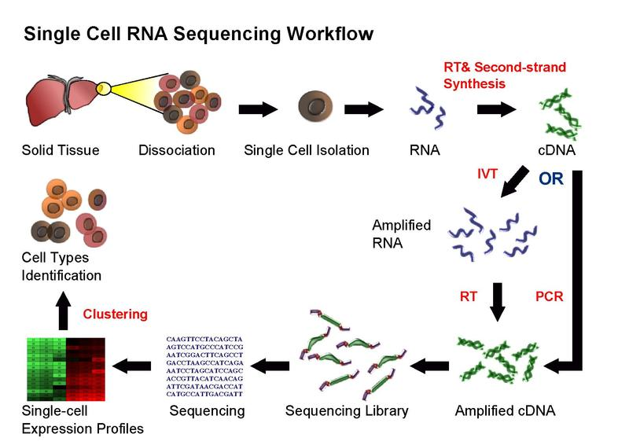
workflow
Good sample preparation is key to success!
Source: https://en.wikipedia.org/wiki/Single_cell_sequencing

Slide 9
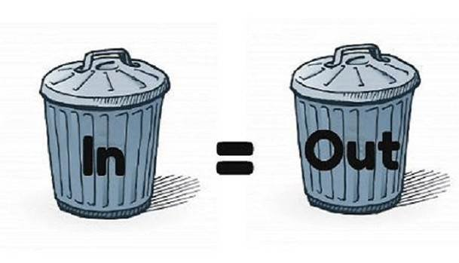
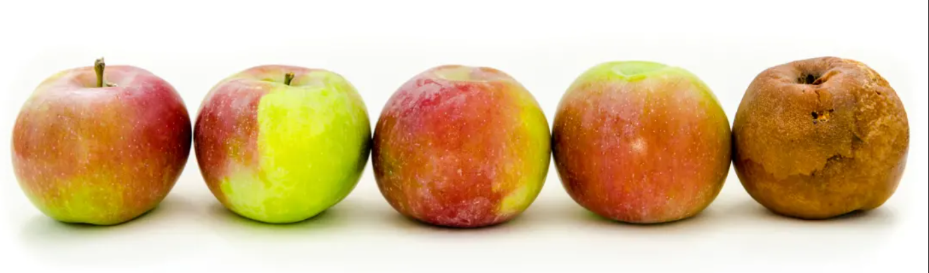
SAMPLE preparation
Understand well the nature of the sample (sampling conditions, preparation, purity)
Identify the source of technical effects to help resolving them
Practice your sample preparation, optimise the protocol well, do not rush to the final experiment
A well planned pilot experiment is essential for evaluating sample preparation and for understanding the required number of cells.
You need your cells to be highly viable (>90-95%), have no clumps and no debris. Cell membrane integrity is a must!
Gentle treatment, short sample preparation, low temperature. Protocols will vary for different cell type
Usual buffer: PBS with 0.1-1% BSA (no EDTA, Mg+, Ca+, Tween)
Free-floating RNA will make analysis more challenging
Be cautious about FACS (especially with more fragile cells). If FACS necessary for enrichment, remember that time is crucial factor
Count with haemocytometer or cell counter (Countess II Automated Cell Counter) – do not trust sorter counts
Fixation and cryopreservation are not compatible with many techniques – and generally should be avoided if possible (Nuc-seq might be a solution for frozen samples)

Slide 10
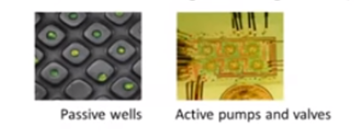
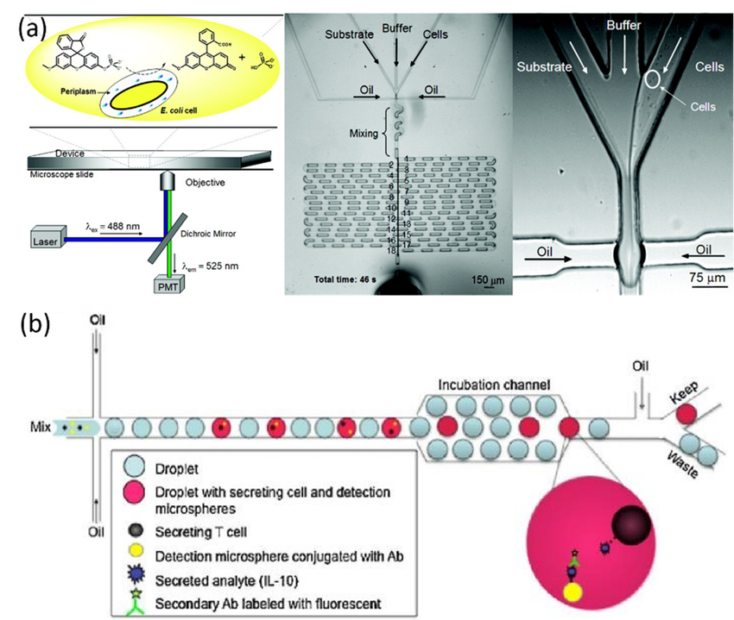
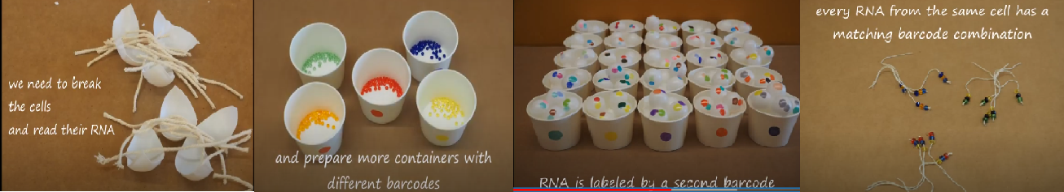
Technologies
Cells in wells, traps and valves (nanowell, Flow sorting, CellenOne,
Fluidigm C1, SmartSeq)
- Screen for and retrieve single cells of interest
- Enrich for rare cells wit decided properties
- Control the cellular microenvironment
- Monitor and control cell-cell interactions
- Precise/extensive manipulation of single cells
2) Droplets (Drop-seq, 10x Genomics)
Introduce distinct ‘packets’ of reagents to single cell (e.g. barcodes)
Perform amplification on individual cells
Sort large population of single cells
3) Combinatorial indexing (SCI-seq, SPLiT-seq)
Economic use of reagents for cell separation
Efficiency of handling larger population than Drop-seq
Maintain complexities of population without bias from droplet or well
Source: Wen et al. Molecules (2016)
Source: https://sites.google.com/uw.edu/splitseq

Slide 11
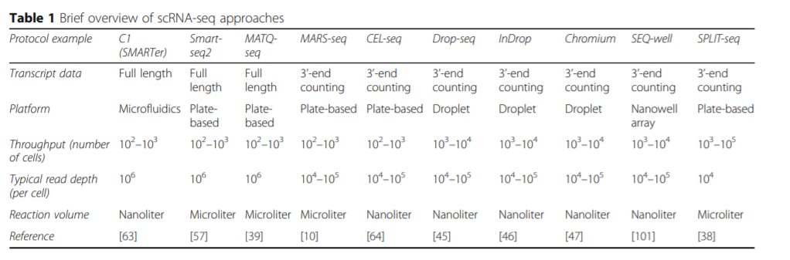
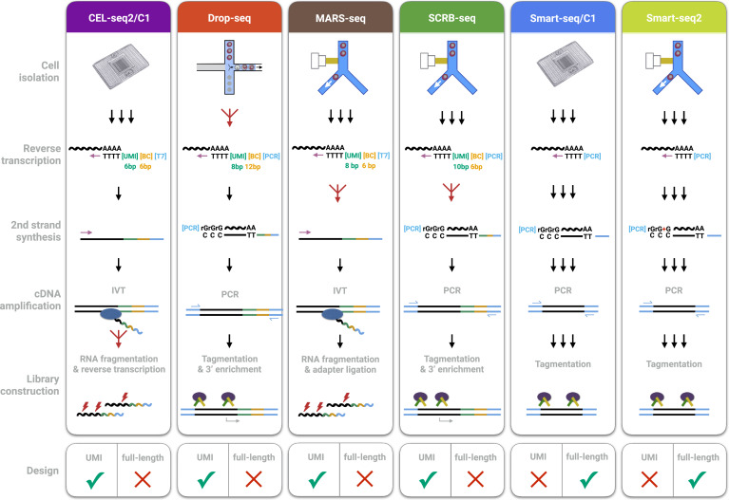
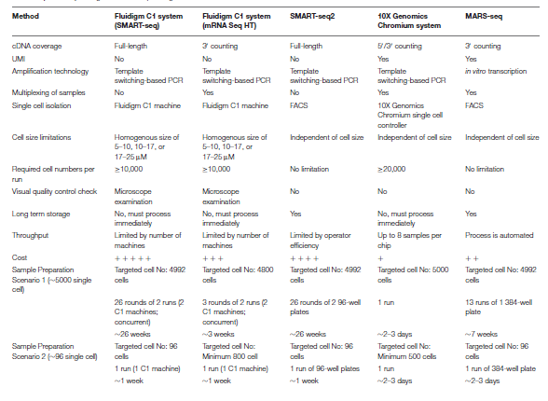
Comparison of technologies
Source: Haque et al. Genome Med 9, 75 (2017)
Source: Ziegenhain et al. Mol Cell. 65 (4). (2017)
Source: See et al. Frontiers in immunology, 9, 2425. (2018)

Slide 12
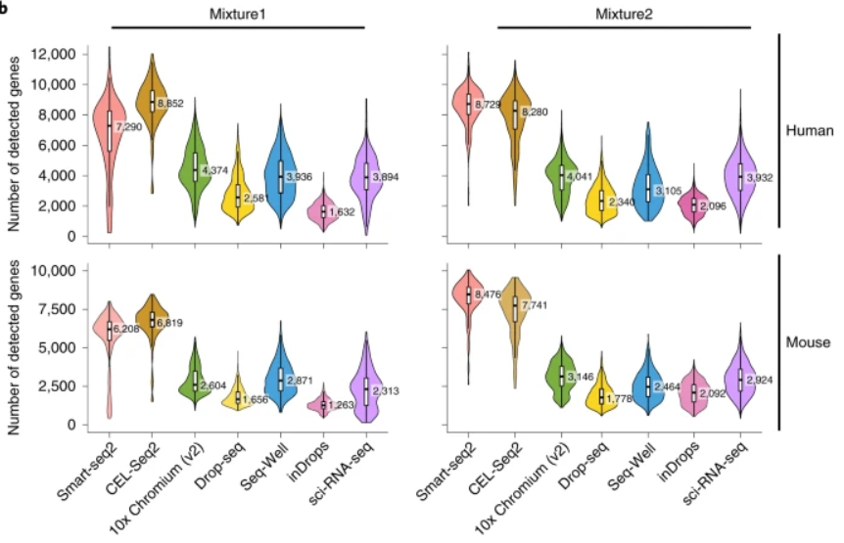
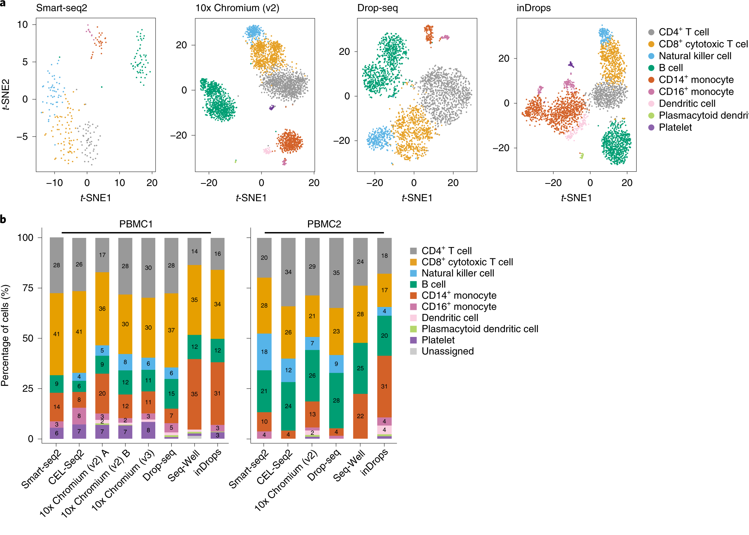
Performance
Distribution of the number of genes in human (top) or mouse (bottom) cells in the two Mixture experiments.
Cell type identification and assignment in PBMCs
Source: Ding et al. Nat Biotechnol 38, 737–746 (2020).

Slide 13
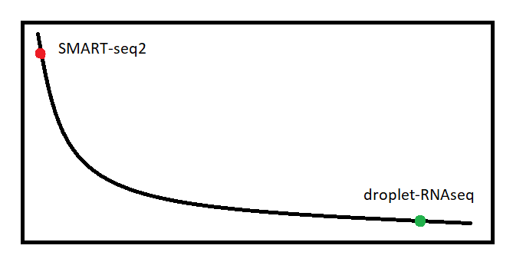
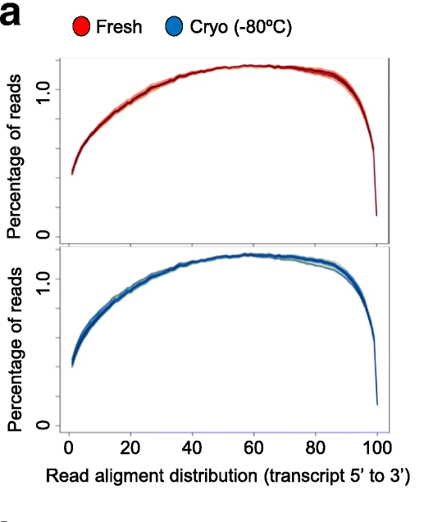
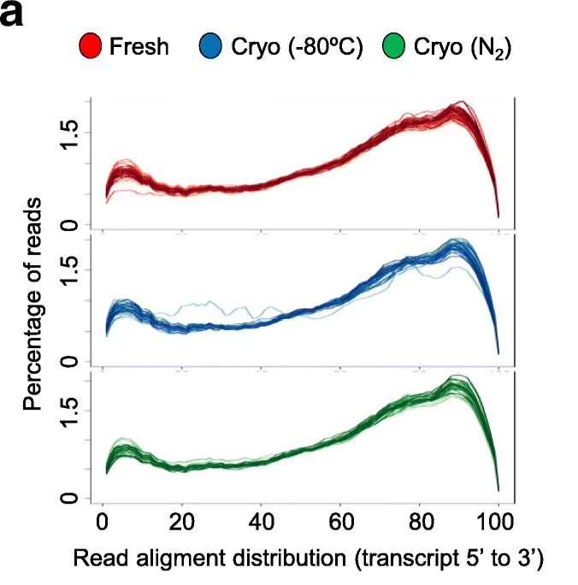
More CELLs or MORE GENES?
SMART-seq2
100 cells
Full-length libraries
1M reads per cell
Droplet-RNAseq
10000 cells
50k reads per cell
3’/5’ bias
Required number of cells increases with complexity of the sample.
Number of reads will depend on biology of sample
Cell-type classification of a mixed population usually requires lower read depth
You can always re-sequence your samples.
Source: Guillaumet-Adkins, et al. Genome Biol 18, 45 (2017).

Slide 14
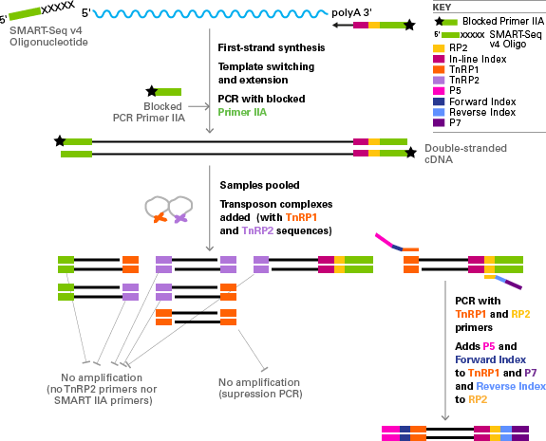
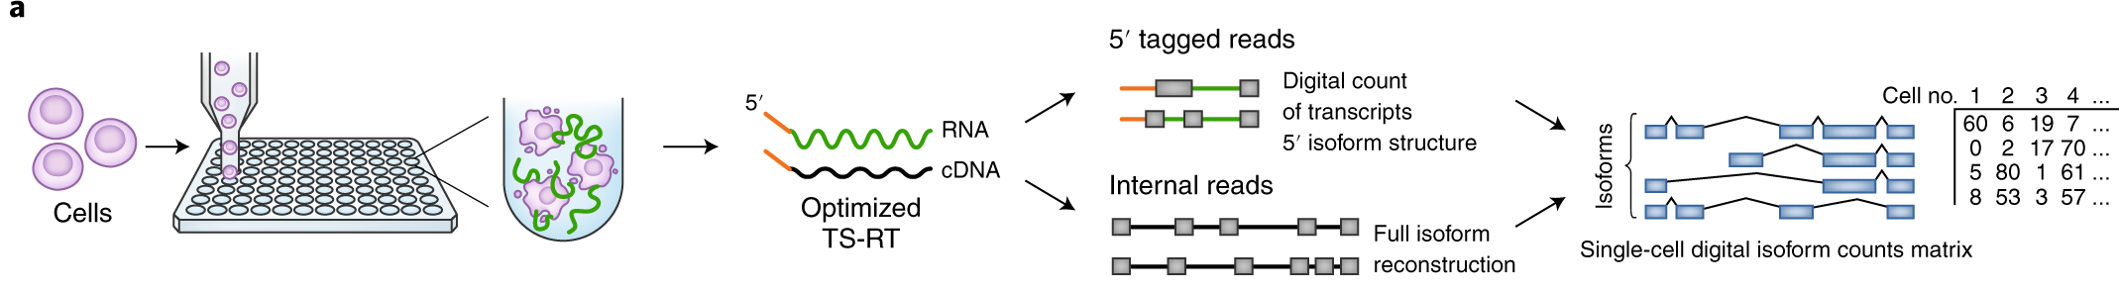
SMART-SEQ2/3/4 overview
Developed for single cell but can performed using total RNA.
•Selects for poly-A tail.
•Full transcript assay.
Uses template switching for 5' end capture.
•Standard illumina sequencing.
•Plate-based solution so labour intensive, slow and costly (~$12/cell)
Source: TakaraBio
Source: Macosko, Nat Biotechnol 38 (2020).

Slide 15
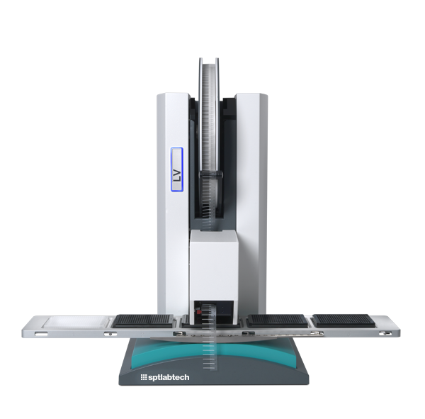
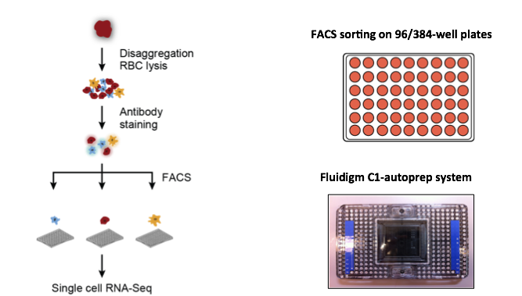
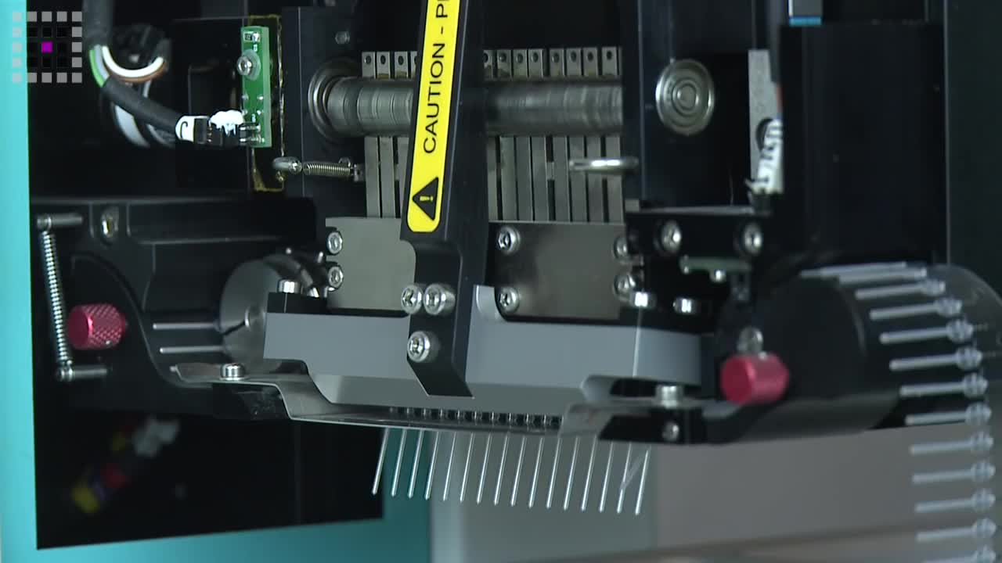
SMART-SEQ2/3/4 + Mosquito
Source: SPT Labtech
Mosquito LV makes assay miniaturisation simple, leading to significant savings on precious reagents and time.
Mosquito LV offers highly accurate and precise multichannel pipetting from 25 nL to 1.2 µL.
SmartSeq2 cost reduced from $12 to $4 per cell
Source: SPT Labtech

Slide 16
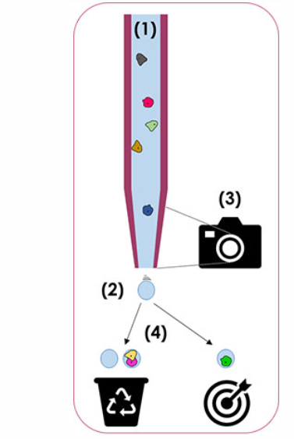
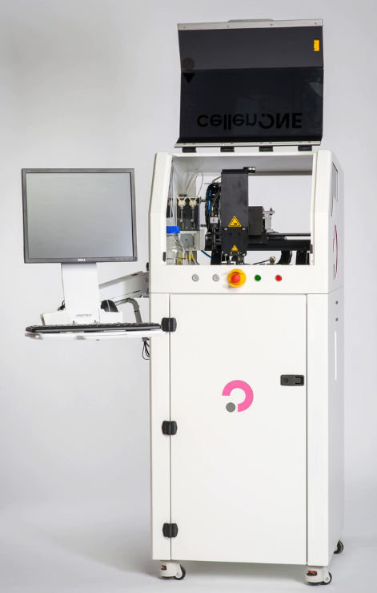
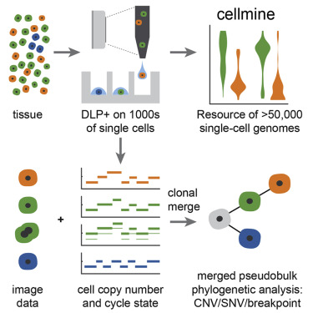
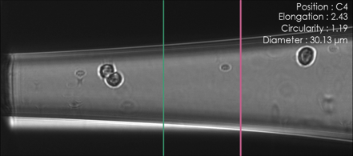
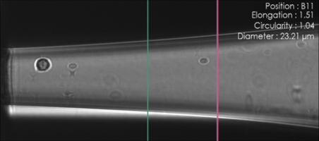
CELLEnOne
Cell suspension is aspirated into a glass capillary
Generation of drops on demand, in air
Thanks to automated imagining, cellenONE tracks cells and determines if upcoming drops will contain or not a single cell
Drops containing single cells are dispensed into selected targets, drops without cells or with more than one cells are dispensed into recycling tube
Source: Cellenion
Source: Cellenion
Source: Cellenion
Source: Laks et al. Cell. 179(5):1207-1221.e22. (2019)

Slide 17
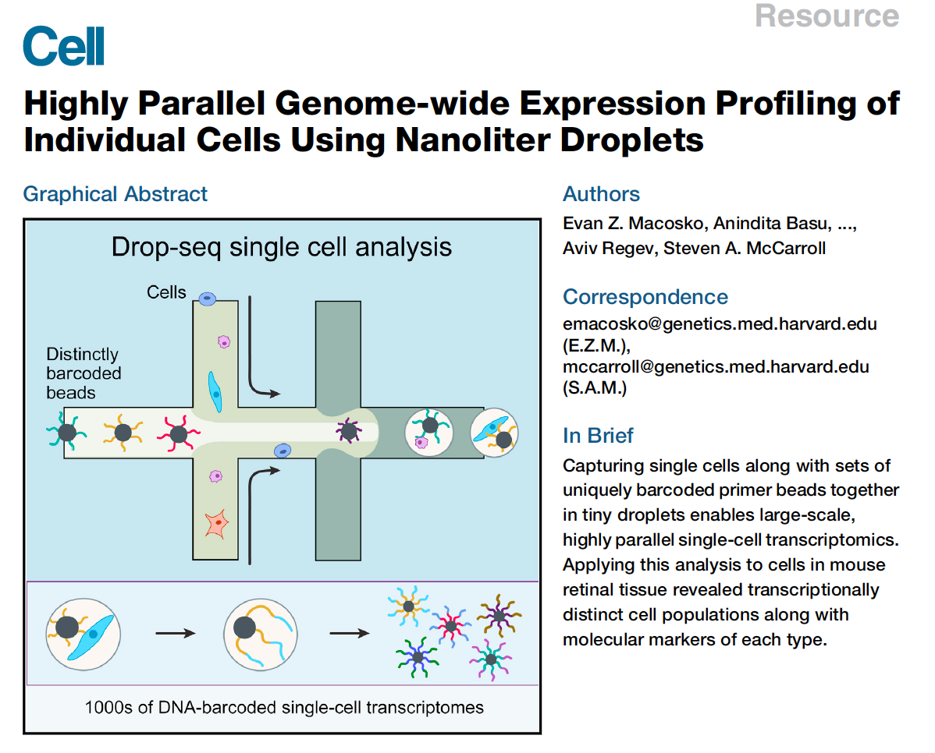
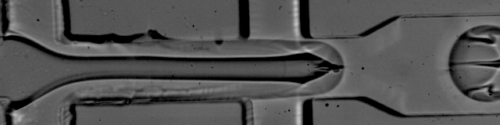
DROP-SEQ overview
Moved throughput from hundreds to thousands.
Droplet-based processing using microfluidics
Nanoliter scale aqueous drops in oil.
3' End
Bead based (STAMPs).
Single-cell transcriptomes attached to microparticles.
Cell barcodes use split-pool synthesis.
Uses UMI (Unique Molecular Identifier)
Chance to have two cells within one droplet

Slide 18
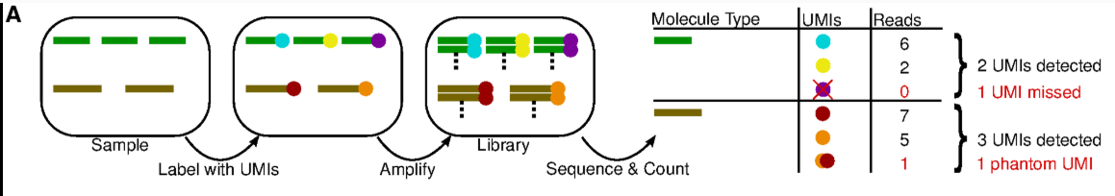
UMI – unique molecular identifiers
After PCR enrichment, without UMIs, one can not distinguish if multiple copies of a fragment are caused by PCR clones or if they are real biological duplicated. By using UMIs, PCR clones can be found by searching for non-unique fragment-UMI combinations, which can only be explained by PCR clones.
When performing variant analyses, these falsely overrepresented fragments can result in incorrect calls and thus wrong diagnostic findings
Source: Pflug et al. Bioinformatics (2018)
The relevant steps of library preparation when the UMI method is used. The sample initially contains three copies of molecule graphic and two copies of graphic, which are made unique by labelling with UMIs (graphic). Each of those molecules is expanded into a molecular family during amplification, and a random selection of molecules from these families is sequenced. Counting unique UMIs then counts unique molecules, unless UMIs have read-count zero (graphic) or phantom UMIs are produced (graphic).

Slide 19
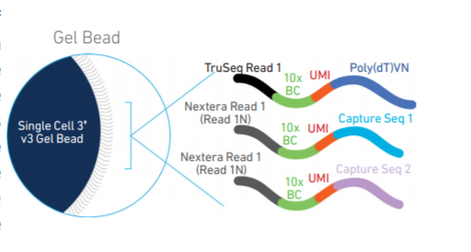
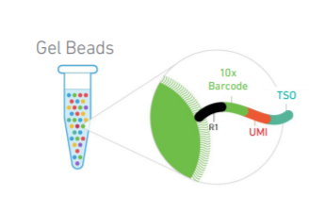
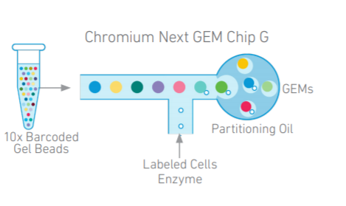
10x Genomics overview
- Droplet-based similar to Drop-Seq, 3’ or 5’ mRNA
- In contrast to Drop-seq, where solid beads are used for RNA capture, 10X uses soft hydrogels containing oligos. These enable “single Poisson loading” leading to capture of >60% of input cells.
Standardized instrumentation and reagents (unhackable so no customisation or control)
Very easy to use and less processing time
More high-throughput scaling - 8 samples can be processed simultaneously with up to 10000 cells captured per sample
The doublet rate increases with number of cells loaded
CellRanger and CellLoupe software is available and user friendly
Source: 10x Genomics

Slide 20
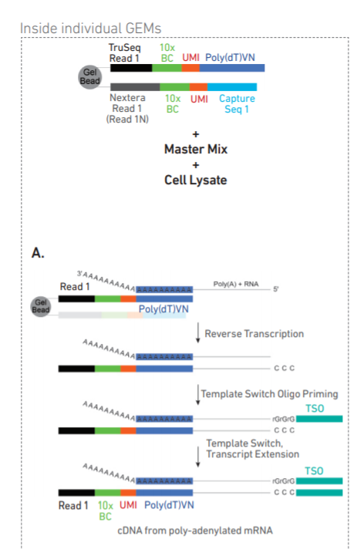
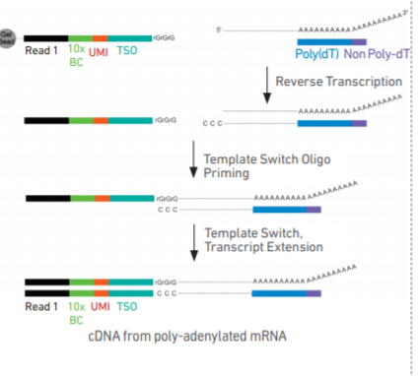


10x Genomics overview
Source: 10x Genomics

Slide 21



10x Genomics overview
Source: 10x Genomics

Slide 22


10x Genomics libraries
Source: 10x Genomics
Sequencing Read | Description | Number of cycles
Read1 | 10x Barcode Read (Cell) + Randomer Read (UMI) | 28bp
i7 index | Sample index read | 8bp (soon 10bp)
i5 index | Sample index read | 0 (soon 10bp)
Read2 | Insert Read (Transcripti) | 91bp (soon 90bp)

Slide 23




CITE-SEQ: Cellular Indexing of Transcriptomes and Epitopes by Sequencing
Source: BioLegend
Source: cite-seq.com
CITE-seq uses DNA-barcoded antibodies to convert detection of proteins into a quantitative, sequenceable readout.
Source: 10x Genomics
Source: Stoeckius et al. Nat Methods. (2017)

Slide 24




CELL hashing
Reduces cost of running multiple samples by adding hashtag oligos and pooling into single channel of 10x chip
Allows overloading as by sequencing tags alongside the cellular transcriptome, we can assign each cell to its sample of origin, and robustly identify doublets originating from multiple samples
Source: cite-seq.com

Slide 25


Isoforms
10x 5’ VDJ kit: profiles full length (5’ UTR to constant
region) paired T-cell receptor (TCR), or B-cell
immunoglobulin (Ig) transcripts.
If both T and B cells are expected to be present in the cell
population, TCR and Ig transcripts can be enriched in
separate reactions from the same amplified cDNA material.
Source: 10x Genomics
Source: Arzalluz-Luque, Á., Conesa, A. Genome Biol 19, 110 (2018).
Source: 10x Genomics

Slide 26



CRISPR screening
Source: 10x Genomics
Source: https://cite-seq.com/eccite-seq/
Source: 10x Genomics

Slide 27


Single cell ATAC-seq
Sequencing Read | Description | Number of cycles
Read1 | Insert Sequence 1N | 50bp
i7 index | Sample index read | 8bp
i5 index | 10x Barcode Read (Cell) | 16bp
Read2 | Insert Sequence 2N (opposite end) | 50bp
Source: 10x Genomics

Slide 28


ATAC-seq + RNA-SEQ
Source: 10x Genomics

Slide 29


TaRGETED panels
Source: 10x Genomics

Slide 30



SPATIAL TRANSCRIPTOMICS
Source: 10x Genomics
Source: Liao et al. Trends in Biotechnology. (2020)
55ul spots -> 1 and 10 cells captured per spot
Source: 10x Genomics

Slide 31


SPATIAL TRANSCRIPTOMICS
Source: 10x Genomics

Slide 32


Experimental design
Source: Baran-Gale et al. Brief Func Genomics. 17 (4):233–239. (2018)
Source: Nguyen QH et al. Front Cell Dev Biol 6:108. (2018)

Slide 33
What platform Should I use?
Choose protocol based on:
- Throughput (number of cells per reaction )
- Sample of origin
- Cost / Labour / Time limitations
- Gene body coverage: 5’/ 3’ biased or full-length?
- UMI vs no-UMI
- Sequencing depth per cell
Examples:
If you sample is fairly homogeneous – bulk RNAseq
If your sample is limited in cell number – plate-based method
If you want re-annotate the transcriptome and discover new isoforms – full-length coverage (SMART-seq2)
If you are looking to classify all cell types in a diverse tissue - high throughput
If you have only archival human samples – nuclei isolation

Slide 34

Literature:
Pijuan-Sala, B., Griffiths, J.A., Guibentif, C. et al. A single-cell molecular map of mouse gastrulation and early organogenesis. Nature 566, 490–495 (2019).
Wilk, A.J., Rustagi, A., Zhao, N.Q. et al. A single-cell atlas of the peripheral immune response in patients with severe COVID-19. Nat Med 26, 1070–1076 (2020).
Plasschaert, L.W., Žilionis, R., Choo-Wing, R. et al. A single-cell atlas of the airway epithelium reveals the CFTR-rich pulmonary ionocyte. Nature 560, 377–381 (2018).
Macosko, E.Z. Single-cell RNA sequencing at isoform resolution. Nat Biotechnol 38, 697–698 (2020). https://doi.org/10.1038/s41587-020-0553-9
Svensson, V., Natarajan, K., Ly, L. et al. Power analysis of single-cell RNA-sequencing experiments. Nat Methods 14, 381–387 (2017).
Svensson, V., Vento-Tormo, R. & Teichmann, S. Exponential scaling of single-cell RNA-seq in the past decade. Nat Protoc 13, 599–604 (2018).
https://www.slideshare.net/TimothyTickle/introduction-to-singlecell-rnaseq
https://hbctraining.github.io/scRNA-seq/slides/Single_Cell_2_27_20.pdf.
Roy, Ananda & Conroy, Richard & Smith, Jessica & Yao, Yong & Beckel-Mitchener, Andrea & Anderson, James & Wilder, Elizabeth. Accelerating a paradigm shift: The Common Fund Single Cell Analysis Program. Science Advances. 4. (2018).
Wen, Na & Zhao, Zhan & Beiyuan, Fan & Chen, Deyong & Men, Dong & Wang, Junbo & Chen, Jian. (2016). Development of Droplet Microfluidics Enabling High-Throughput Single-Cell Analysis. Molecules. 21. (2016)
https://sites.google.com/uw.edu/splitseq
See, P., Lum, J., Chen, J., & Ginhoux, F. A Single-Cell Sequencing Guide for Immunologists. Frontiers in immunology, 9, 2425. (2018)
Laks E, McPherson A, Zahn H, et al. Clonal Decomposition and DNA Replication States Defined by Scaled Single-Cell Genome Sequencing. Cell. 179(5):1207-1221.e22. (2019)
Ziegenhain C, Vieth B, Parekh S, et al. Comparative Analysis of Single-Cell RNA Sequencing Methods. Mol Cell. 65(4):631-643.e4. (2017)
Ding, J., Adiconis, X., Simmons, S.K. et al. Systematic comparison of single-cell and single-nucleus RNA-sequencing methods. Nat Biotechnol 38, 737–746 (2020).
Haque, A., Engel, J., Teichmann, S.A. et al. A practical guide to single-cell RNA-sequencing for biomedical research and clinical applications. Genome Med 9, 75 (2017).
Guillaumet-Adkins, A., Rodríguez-Esteban, G., Mereu, E. et al. Single-cell transcriptome conservation in cryopreserved cells and tissues. Genome Biol 18, 45 (2017).
Jeanette Baran-Gale, Tamir Chandra, Kristina Kirschner, Experimental design for single-cell RNA sequencing, Briefings in Functional Genomics, Volume 17, Issue 4, Pages 233–239 (2018)
Stoeckius M, Hafemeister C, Stephenson W, et al. Simultaneous epitope and transcriptome measurement in single cells. Nat Methods. (2017)
Arzalluz-Luque, Á., Conesa, A. Single-cell RNAseq for the study of isoforms—how is that possible?. Genome Biol 19, 110 (2018).
Nguyen QH, Pervolarakis N, Nee K, Kessenbrock K. Experimental Considerations for Single-Cell RNA Sequencing Approaches. Front Cell Dev Biol 6:108. (2018)
Hwang B, Lee JH, Bang D. Single-cell RNA sequencing technologies and bioinformatics pipelines. Exp Mol Med.50(8):96. (2018)
Jie Liao, Xiaoyan Lu, Xin Shao, Ling Zhu, Xiaohui Fan. Uncovering an Organ’s Molecular Architecture at Single-Cell Resolution by Spatially Resolved Transcriptomics. Trends in Biotechnology. (2020)

Slide 35

THANK you for your attention!

